Slide 1
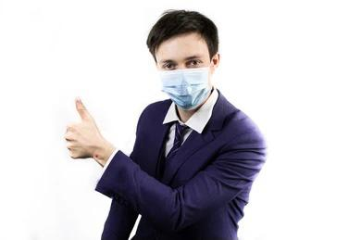
COVID-19 PRECAUTION TECHNIQUE BY REAL TIME FACE MASK DETECTOR USING ML
UNDER THE GUIDANCE OF PROF. Geetha Laxmi
TEAM MEMBERS:
VIJAYA S RAO
KANNIKA V PRABHU
KISHAN KUMAR SHETTY
MONTEIRO AVELINO ANIL

Slide 2

introduction
In order to effectively prevent the spread of COVID19 virus, almost everyone wears a mask during corona virus epidemic.
Face Detection has evolved as a very popular problem in Image processing and Computer Vision.
Training is performed through Fully Convolution Networks to semantically segment out the faces present in that image.
In this project, we’ll discuss our two-phase COVID-19 face mask detector, detailing how our computer vision/deep learning pipeline will be implemented

Slide 3
ABSTRACT
This project is proposed to prevention of coronavirus infection.
This system is a smart edge surveillance system that is effective in remote monitoring.
We will use this Python script to train a face mask detector and review the results.
Given the trained COVID-19 face mask detector, we will proceed to implement two more additional Python scripts used to Detect face masks in real-time video streams
Moreover, the system will help to detect and track the person and record the data.

Slide 4
Problem statement
Main aim of the project here is to predict people wearing masks or not wearing them, given an
image or a video. It is an object detection and classification problem with 2 different
classes(Mask and Without Mask). Another challenge is to train object detection models capable
of identifying the location of masked faces in an image as well as the location of unmasked faces
in the image

Slide 5

EXPECTED OUTCOMES
The system must be able to track anyone in an institution not wearing a mask.
An acknowledgment should be forwarded to the in charge of that person and himself requesting to wear a mask.
To ensure effective use of deep neural networks in identifying different types of masks.

Slide 6
LITERATURE SURVEY
Sl.No | Title | Existing System | Methodology/Algorithm | Drawback
1 | Deep Learning based Safe Social Distancing and Face Mask Detection in Public Areas for COVID19 Safety Guidelines Adherence | Deep learning algorithm and a computer vision | Logistic regression, Random forest | A significant disadvantage of DBNs is that they do not account for the two-dimensional structure of an input image, which may significantly affect their performance and applicability in computer vision and multimedia analysis problems.
2 | Masked Face Recognition Dataset and Application | Masked Face Detection Dataset (MFDD) Real-world Masked Face Recognition Dataset (RMFRD) Simulated Masked Face Recognition Dataset (SMFRD) | The accuracy of masked face recognition is about 85% | Memory based. This client dataset advantage can also be a disadvantage. Because client datasets reside in RAM, their size is limited by the amount of available RAM

Slide 7
LITERATURE SURVEY (CONTINUED)
3 | Multi-Stage CNN Architecture for Face Mask Detection | KNN [k-nearest algorithm] Linear Spectral Pairs-vector quantization | The resultant system exhibits high performance and has the capability to detect face masks in images with multiple faces over a wide range of angles. | 1)Accuracy depends on the quality of the data. 2)With large data, the prediction stage might be slow. 3)Sensitive to the scale of the data and irrelevant features.
4 | Detecting Masked Faces in the Wild with LLE-CNNs | Locally linear embedding(LLE) algorithm | Experimental results on the MAFA dataset show that the proposed approach remarkably out-performs 6 state-of-the-arts by at least 15.6% | One of the drawbacks of LLE is a lack of generalization when new points are to be added, i.e., in this case, we have to rerun LLE on pooled (both old and new) data in order to obtain the embeddings

Slide 8
LITERATURE SURVEY (CONTINUED)
5 | Face Detection and Segmentation Based on Improved Mask R-CNN | The input of the nets is Short Time Fourier Transform(STFT) magnitude spectrum, a stack CNN module used as the feature extractor to learn mid and high level features from the spectrograms | the proposed framework is able to detect faces correctly while also precisely segmenting each face in an image. | 1. Data requirements leading to overfitting & underfitting 2. Parameter-to-memory requirements 3. Non-expressive learning
6 | Improved Face Recognition Rate Using HOG Features and SVM Classifier | face recognition algorithm. | This proposed algorithm is compared with standard Eigen feature based PCA algorithm. Results show that the proposed algorithm is having an improved face recognition rate of 8.75% on ORL database. | HOG shows good performance for human detection . However, it has a disadvantage that is very sensitive to image rotation.

Slide 9
LITERATURE SURVEY (CONTINUED)
7 | COVID-19 FACEMASK DETECTION WITH DEEP LEARNING AND COMPUTER VISION | Decision trees, NB classiﬁers, linear SVMs, DNNs, and RNNs. | This specified model could be used as a use case for edge analytics. Achieve state of art result on a public face mask dataset. | 1)If a categorical variable has a category in the test dataset, which was not observed in training dataset, then the model will assign a 0 (zero) probability and will be unable to make a prediction.
8 | In Face Mask Detection using Transfer Learning of Inception V3 | Decision tree induction algorithm, automatic chord transcription algorithm. HOG and SVM | The proposed transfer learning model achieved accuracy and specificity of 99.92%,99.9% during training, and 100%, 100% during testing on the SMFD dataset. | Small change in the data can lead to a large change in the structure of the optimal decision tree. They are often relatively inaccurate.

Slide 10
HARDWARE REQUIREMENTS
Laptop with Intel i5 Processor and 500GB Hard disk.

Slide 11
software REQUIREMENTS
Dataset with images of people with mask and without mask.
Python3 IDE
Deep Learning Modules like Tensorflow & Keras
Machine Learning Modules like Numpy, Pandas and Sci-Kit Learn
Web Framework: Django
Browser to run Application

Slide 12
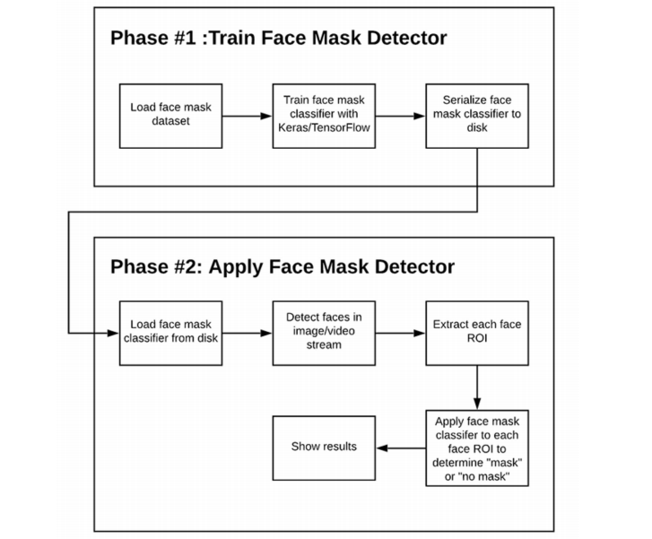
methodology
Our proposed system consists of two parts:
Training Face Mask Detector .
Apply Face Mask Detector

Slide 13
Architecture Overview
Fig. 1 represents our proposed system architecture (input image taken from the dataset by (Larxel, 2020)). It consists of two major stages.
The first stage of our architecture includes a Face Detector, which localizes multiple faces in images of varying sizes and detects faces even in overlapping scenarios. The detected faces (regions of interest) extracted from this stage are then batched together and passed to the second stage of our architecture, which is a CNN based Face Mask Classifier. The results from the second stage are decoded and the final output is the image with all the faces in the image correctly detected and classified as either masked or unmasked faces.

Slide 14
Stage 1 - Face Detector
A face detector acts as the first stage of our system. A raw RGB image is passed as the input to this stage. The face detector extracts and outputs all the faces detected in the image with their bounding box coordinates. The process of detecting faces accurately is very important for our architecture. Training a highly accurate face detector needs a lot of labeled data, time, and compute resources. For these reasons, we selected a pre-trained model trained on a large dataset for easy generalization and stability in detection.

Slide 15
Stage 2 - Face Mask Classifier
The second stage of our system is a face mask classifier. This stage takes the processed ROI from the Intermediate Processing Block and classifies it as either RMFRD images were biased towards Asian faces. Thus, masked images from the Larxel (Kaggle) were added to the dataset to eliminate this bias. RMFRD contains images for unmasked faces as well. However, as mentioned before, they were heavily biased towards Asian faces. Hence, we decided not to use these images. The Flickr-Faces-HQ (FFHQ) dataset introduced by (Karras et al., 2019) was used for unmasked images. Our dataset also includes images of improperly worn face masks or hands covering the face, which get classified as non masked faces.

Slide 16
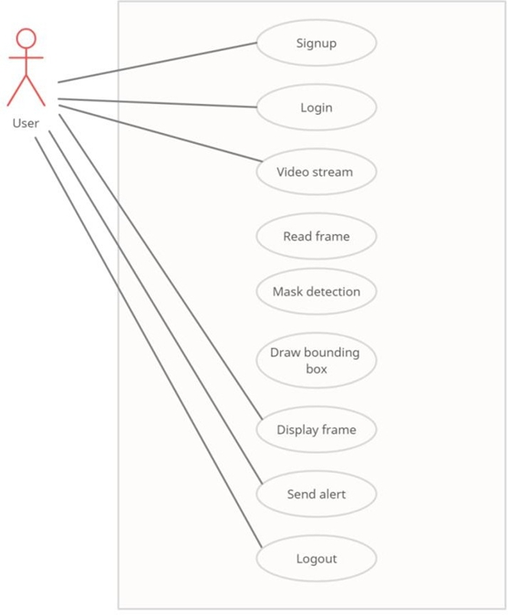
Use CASE diagram
Figure 4.1.2 Use Case diagram
Use case diagrams are used to gather the requirements of a system including internal and external influences. These requirements are mostly design requirements. Hence, when a system is analysed to gather its functionalities, use cases are prepared and actors are identified.

Slide 17
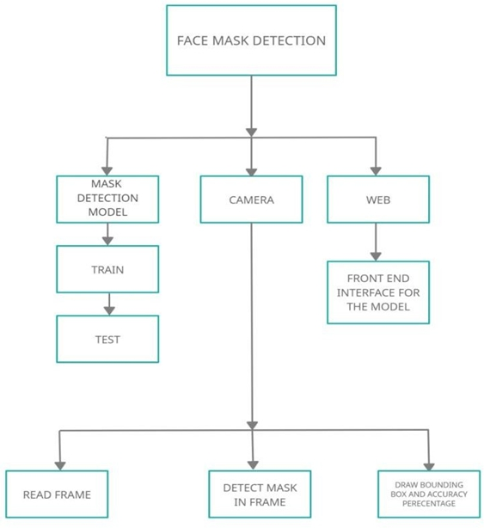
Modular Design Diagram
A modular design can be characterized by functional partitioning into discrete scalable and reusable modules, rigorous use of well-defined modular interfaces, and making use of industry standards for interfaces. In this context modularity is at the component level, and has a single dimension, component slot ability. A modular system with this limited modularity is generally known as a platform system that uses modular components.

Slide 18
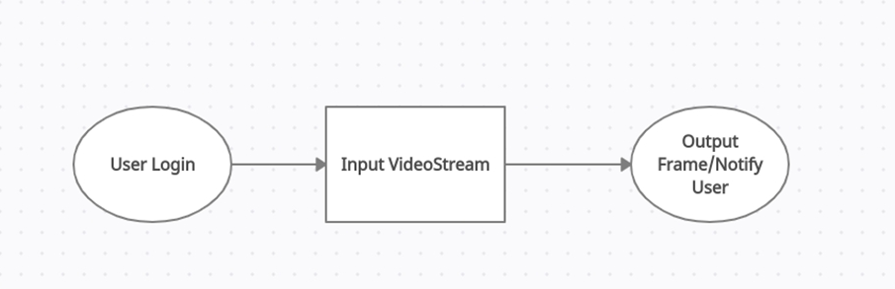
DATA FLOW DIAGRAM
Fig 4.2.2 Level 0 DFD-Frame Extraction of the proposed system

Slide 19
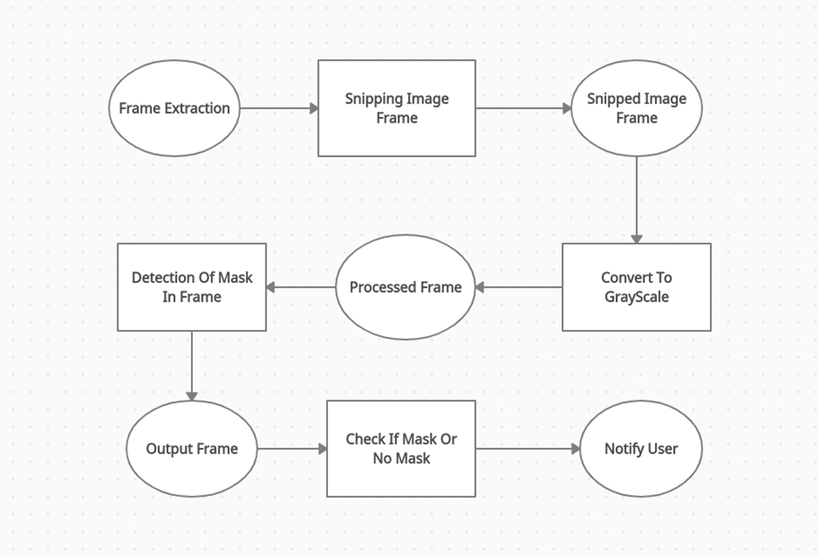
Fig 4.2.2.1 Level 1 DFD-Mask Detection of the proposed system

Slide 20
SEQUENCE DIAGRAM
A sequence diagram shows object interactions arranged in time sequence. It depicts the objects involved in the scenario and the sequence of messages exchanged between the objects needed to carry out the functionality of the scenario. Sequence diagrams are typically associated with use case realizations in the Logical View of the system under development. Sequence diagrams are sometimes called event diagrams or event scenarios

Slide 21
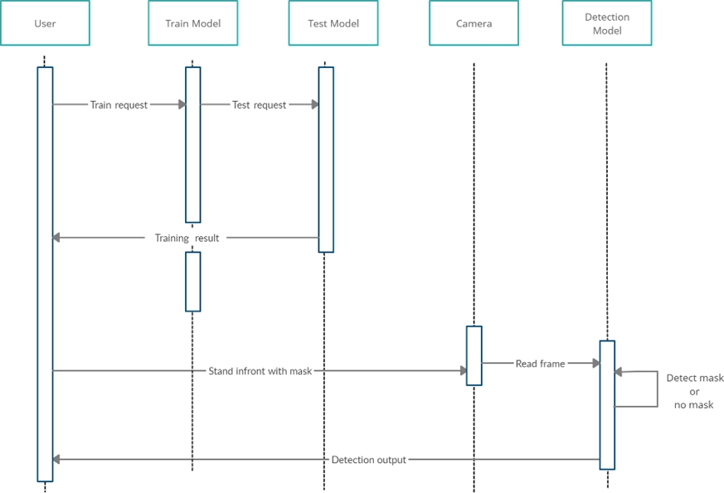
Figure 4.2.3 sequence diagram

Slide 22
COMPLETE CONTROL FLOW DIAGRAM
It is common practice to draw the context-level data flow diagram first, which shows the interaction between the system and external agents which acts as data source and data sinks. On the context diagram the system’s interactions with the outside world are modelled purely in terms of data flows across the system boundary. The context diagram shows the entire systems the single process, and gives no clues as to its internal organization.

Slide 23
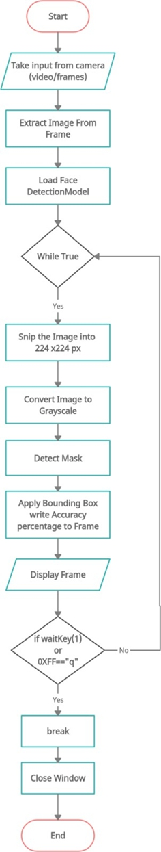
Figure 4.3.1 Control flow diagram

Slide 24
iMPLEMentation
5.1 Algorithm to detect mask video
Step 1: To determine whether the camera is turned on by pressing the button.
Step 2: If a request, such as a POST, is made, the display is turned on.
Step 3: To detect a face, get the frame dimension and use it to build a box.
Step 4: Move the box through the network to acquire a face detection.
Step 5: Create a catalogue of faces and a network to predict face masks.
Step 6: To move through every detection and filter out weak detection, use a for loop.
Step 7: Calculate the area of a box using x and y values.
Step 8: Check that the border box is inside the frame's dimensions.

Slide 25
Step 9: Add the face and boundary boxes to the appropriate lists.
Step 10: Only make predictions if at least one face is found.
Step 11: Loop through frames of a video stream to determine face in the frame are wearing a mask.
Step 12: A loop was discovered over a face mask.
Step 13: On the output frame, show a rectangle boundary box.
Step 14: Display the output frame.
We make use of face mask detection algorithm which simplifies the data set from maser to in masked. The user is shown with a login page which show the credentials such as login and password.The details is stored in database who ever logs in the system. After the login page python script with its later run and connected with the camera. A boundary is drawn against the user face. The dimensions are mention in the code identifies the an object and detect whether a person is wearing a mask or not.

Slide 26
code effeciency and CODE DETAILS
Code details
●Data Visualization : The collected images in the dataset are visualized and labelled either with mask or without mask.
●Data Augmentation : Here, we augment our dataset to include more images for training.
●Splitting the Data : We split our data set into a training set in which our ML model will be trained and the test set with which the model will be tested.
●Building a Model : In the next step we build our CNN model which contains many hidden layers such as MaxPooling2D, Flatten, Dropout and Dense.
●Training the Model : In this step we fit our images in the training set and the test set to our model which was built using Keras library.
●Labeling the Information : Here, we label two possibilities of our result. ‘0’ for without a mask and ‘1’ for a mask. We are also setting the boundary rectangle using RGB values.[Red for without a mask and Green for a mask.]

Slide 27
code effeciency and CODE DETAILS
Code details
● Importing a Face detection program : Here, we are using the Haar Feature-based Cascade Classifiers for detecting the face.
●Detecting Face Mask : Using the Cascade Classifier we run an infinite loop to detect a face, with which the model can predict possibilities of two cases.
●Alert System : Depending on the prediction, the alert system initiates to send appropriate notifications

Slide 28
CODE EFFECIENCY
Code efficiency is directly linked with algorithm efficiency and the speed of the runtime execution for
software. It is the key element in ensuring high performance. The goal of code efficiency is to reduce
resource consumption and completion time as much as possible with minimum risk to the business or
to the operating environment.Our code is reliable, easy to use ,faster and also the code supports for face mask
detection in real time as well as in recorded videos.

Slide 29
tESTING
Software testing is the process used to help identify the correctness, completeness, security and quality of developed computer software. This includes the process of executing the program or application with the intent of finding errors. Quality is not an absolute it is value to some person. With that in mind testing can never completely establish the correctness of arbitrary comport software; testing furnishes a criticism or comparison that compares the state and behaviour of product against a specification.

Slide 30
Testing Objective
Testing is carried out to ensure that this software is designed according to the needs of the user.
Testing further enhances the quality of the software and makes sure that the product is error free.
To guarantee that all the verification and validation is done.
Ensure that all the verification and validation is done.
Testing is a process of executing a program with the intent of finding errors.
A successful test case is one that uncovers an as-yet-undiscovered error.
A good test case design is one that has a high probability of finding an undiscovered error.
It will uncover potential errors and bug entry points in the software.
Data collected as testing is conducted provide a good indication of software reliability and indication of software quality as a whole.
It will demonstrate that software functions appear to be working according to specification that behavioral and performance requirements appear to have been met.

Slide 31
Testing principal:
All tests should be noticeable to customer requirements, test should be planned long before testing begins, the Pareto principal applies to software testing, testing should begin “in the small” and progress toward testing “in the large”, exhaustive testing is not possible and to be most effective, testing should be conducted by an independent third party.
Testing method
System testing is the stage of implementation. This is to check whether the system after works accurately and efficiently before live operation commences. Testing is the vital to the success of the system. The candidate system is subject to variety of testes: online response, volume, stress, recovery, security and usability tests. A series of tests are performed for the proposed system is ready for user acceptance testing.

Slide 32
The various type of testing on the system is:
Unit testing
Integrated testing
Validation testing
Output testing
User acceptance testing

Slide 33
Testing criteria
Test case | Input | Test description | Output
1 | Capturing Frames | The camera must be able to capture frames from live video | Frames
2 | Face Detection | Bounding box should be drawn around human face only while static | Bounding box drawn around face
3 | Face Detection | Bounding box should be drawn around human face only while moving | Bounding box drawn around face
4 | Mask Detection | The program should be able to de1ect if a person is wearing a mask or not | Bounding box with accuracy percentage.

Slide 34
Testing criteria
Test case | Input | Test description | Output
1 | Password is left blank. | Password can not be blank. | Must enter a password.
2 | Invalid email entered. | Valid email must be entered. | Must enter registered email.

Slide 35
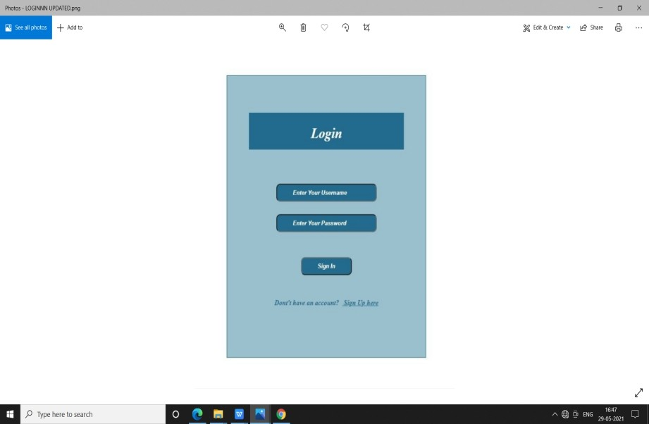
Result
Figure 6.1 login page
We make use of face mask detection algorithm which simplifies the data set from maser to in masked. The User is shown with a login page which show the credentials such as login using email-id and password.

Slide 36
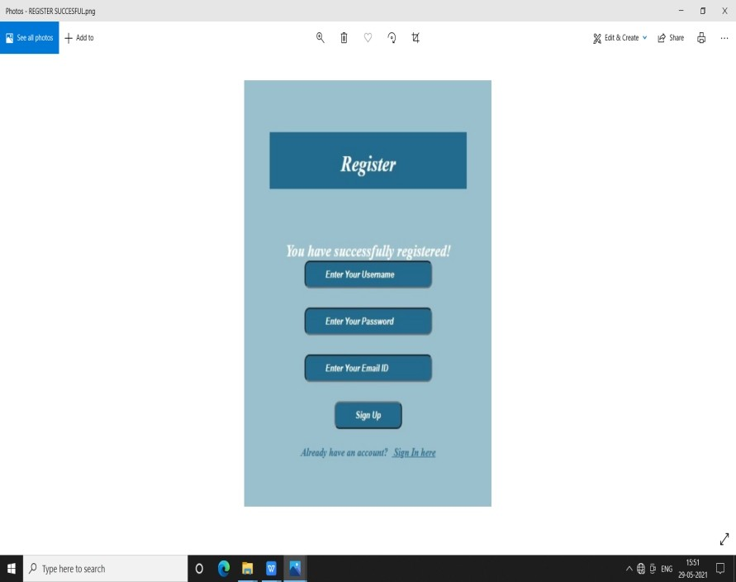
Figure 6.2 Register
From fig 6.2 it displays you have successfully registered. If he has already account ,registered then he can sign-in . If he is new user he has to sign up.

Slide 37
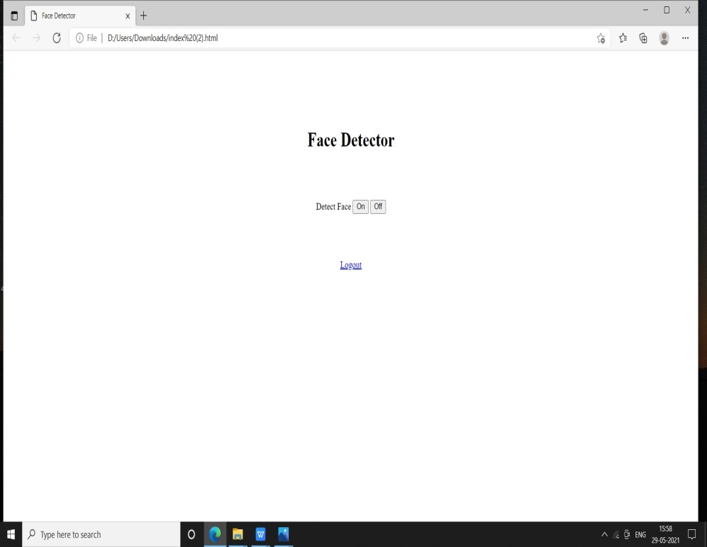
Figure 6.3 Index Page
As shown in figure 6.3 ,the index page we have the buttons on and off. We need to click on ‘on ‘ button Also we have option of logout ,it logs out from system also Python script with its later run and connected with the camera

Slide 38
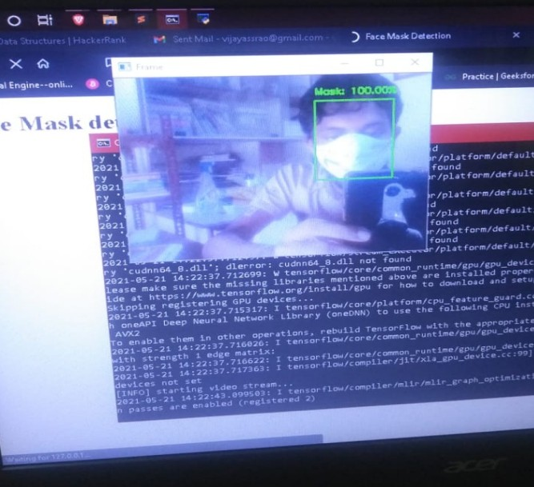
Figure 6.4 Masked face
A boundary is drawn against the user face. The dimensions are mentioned in the code identifies the an object and detect whether a person is wearing a mask or not. As shown in figure 6.4 it is a masked face. So it identifies face with mask.

Slide 39
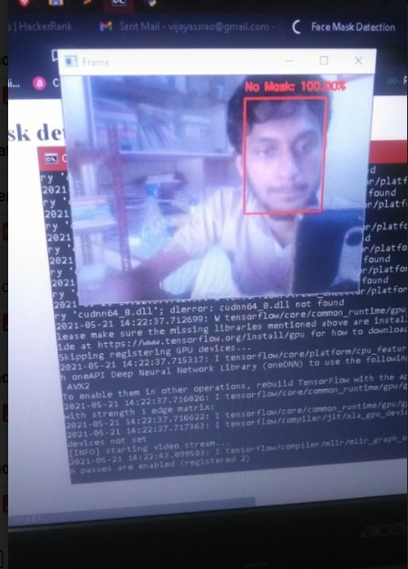
Figure 6.5 Unmasked Face
Figure 6.5 shows it is unmasked face . A boundary is drawn against the user face. The dimensions are mentioned in the code identifies an object and detect whether a person is wearing a mask or not. Now the person has not worn his mask. So it detects no mask.

Slide 40
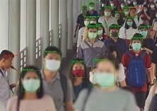
Figure 6.6 Masked and Unmasked Faces
In the above figure 6.6, it shows people wearing and not wearing mask. The system detects the image whether it is masked or unmasked.

Slide 41
CONCLUSION
Thus, this proposed system will operate in an efficient manner in the current situation when the lockout is eased and helps to track public places easily in an automated manner. We have addressed in depth the tracking of social distancing and the identification of face masks that help to ensure human health.

Slide 42
REFERENCES
[1] Deep Learning based Safe Social Distancing and Face Mask Detection in Public Areas for COVID19 Safety Guidelines Adherence - https://www.researchgate.net/publication.
[2] Masked Face Recognition Dataset and Application - https://arxiv.org/pdf/2003.09093.pdf
[3] Multi-Stage CNN Architecture for Face Mask Detection - https://www.researchgate.net/publication.
[4] Detecting Masked Faces in the Wild with LLE-CNNs - https://openaccess.thecvf.com.
[5] Face Detection and Segmentation Based on Improved Mask R-CNN https://www.hindawi.com/journals/ddns/2020/9242917/.
[6] Improved Face Recognition Rate Using HOG Features and SVM - https://www.researchgate.net/publication.
[7] COVID-19 Facemask Detection With Deep Learning And Computer Vision.
[8] In Face Mask Detection using Transfer Learning of InceptionV3 - https://arxiv.org/abs/2009.08369

Slide 43


